Slide 1
Overview of Geospatial Data Infrastructure
Training: Monitoring and Early Warning for Floods Location: MOC-Kofi Annan Centre of Excellence in ICT, Accra Ghana
11.04..22

Slide 2
Who Am I? For today I am just David
Position
Professor, University of San Francisco
Director, USF Geospatial Analysis Lab
Principal, Spatial Informatics Group
Example Programs
SERVIR-Mekong & Amazonia
CEC Pyregence
First Street Foundation-Fire Factor
FAO Collect Earth Online
USAID Forest Data Partnership
Example Service
BOD of Climate and Wildfire Institute
Chair BayGeo
Chair NASA ASAC

Slide 3
Objective
Provide the hubs with a baseline of knowledge so that future deployments of web services and computation analysis can be done efficiently while having a profound effect on their environment.
NEEDS: Understand and discuss the geospatial needs of a program
OPTIONS: Compare and contrast the big three cloud providers and on-premises computing solutions.
EXAMPLES: Show an examples of different configuration
DISCUSSION: Because pure presentations are boring
11.04..22

Slide 4
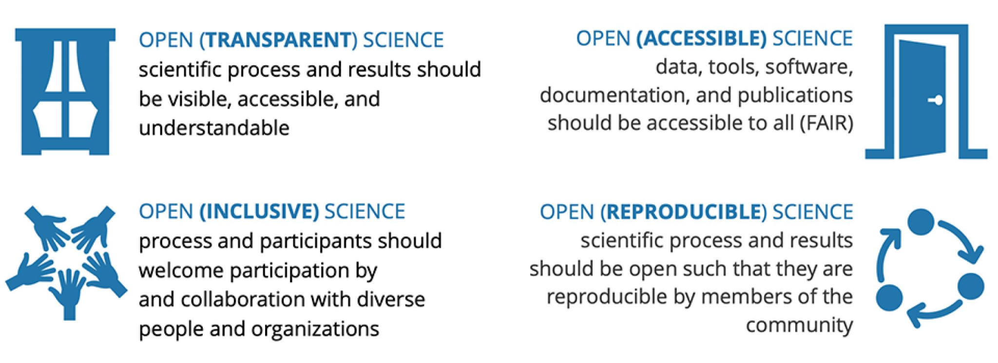

Slide 5
NEEDS
Understand and discuss the geospatial needs of a program
11.04..22

Slide 6
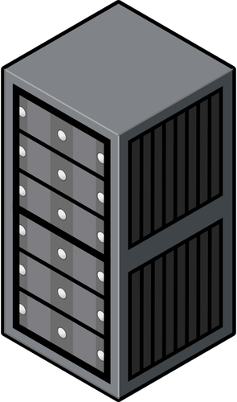
Basic GIT Elements
BANDWIDTH
COMPUTE
STORAGE

Slide 7
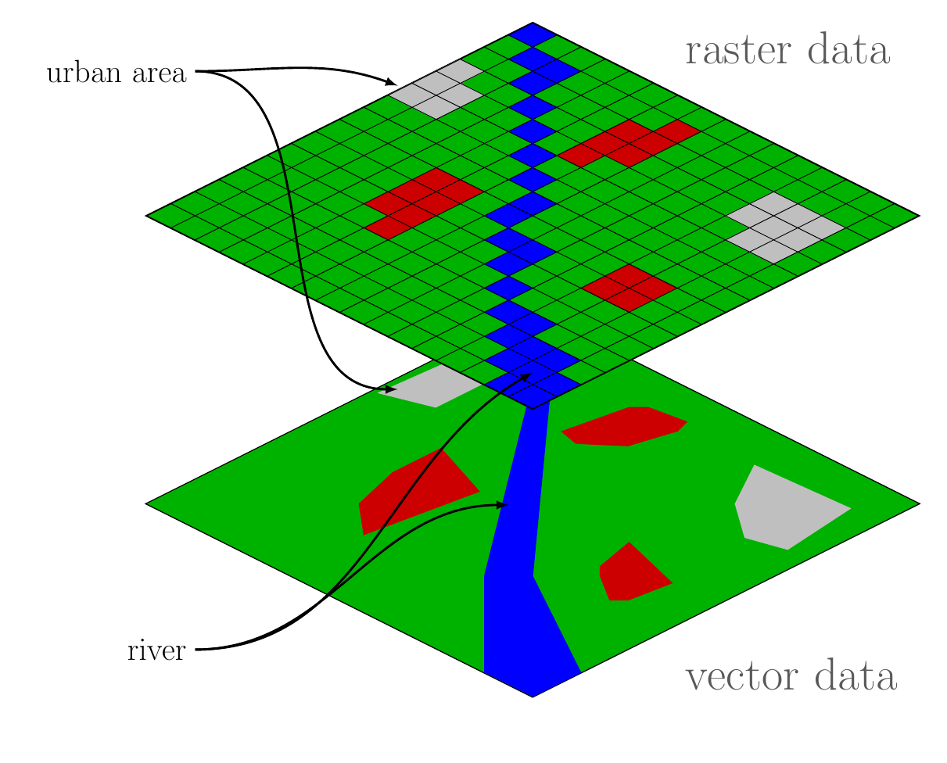
Basic Spatial Elements

Slide 8
Basic Effort
BANDWIDTH
COMPUTE
STORAGE

Slide 9
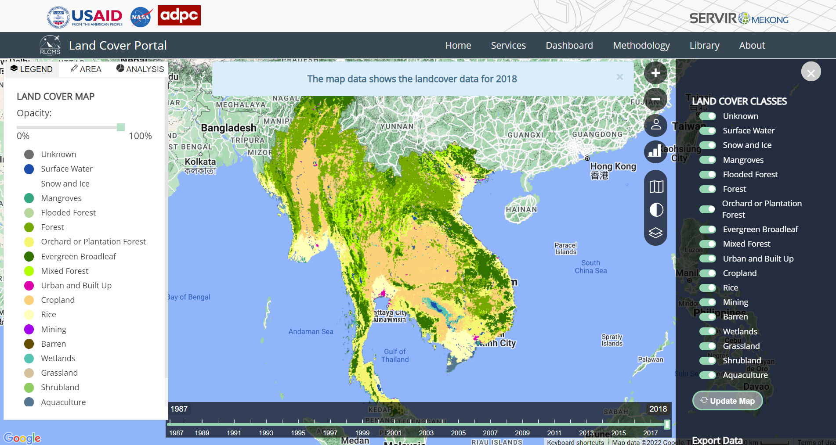
EXAMPLE 1: WEB APP
COMPUTE
BANDWIDTH
STORAGE

Slide 10
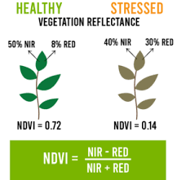
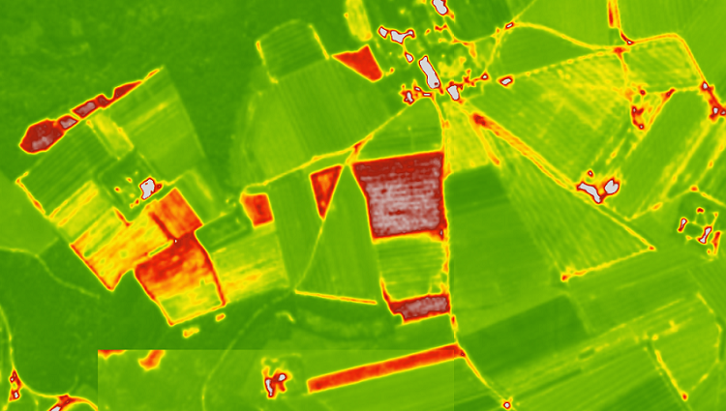
EXAMPLE 2: Pixel Based Analytics
COMPUTE
BANDWIDTH
STORAGE

Slide 11
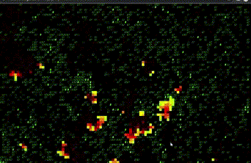
EXAMPLE 3: Raster Based Growth Analytics
COMPUTE
BANDWIDTH
STORAGE

Slide 12
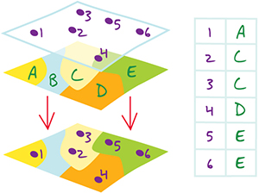
EXAMPLE 4: Vector Based Analytics
COMPUTE
BANDWIDTH
STORAGE

Slide 13
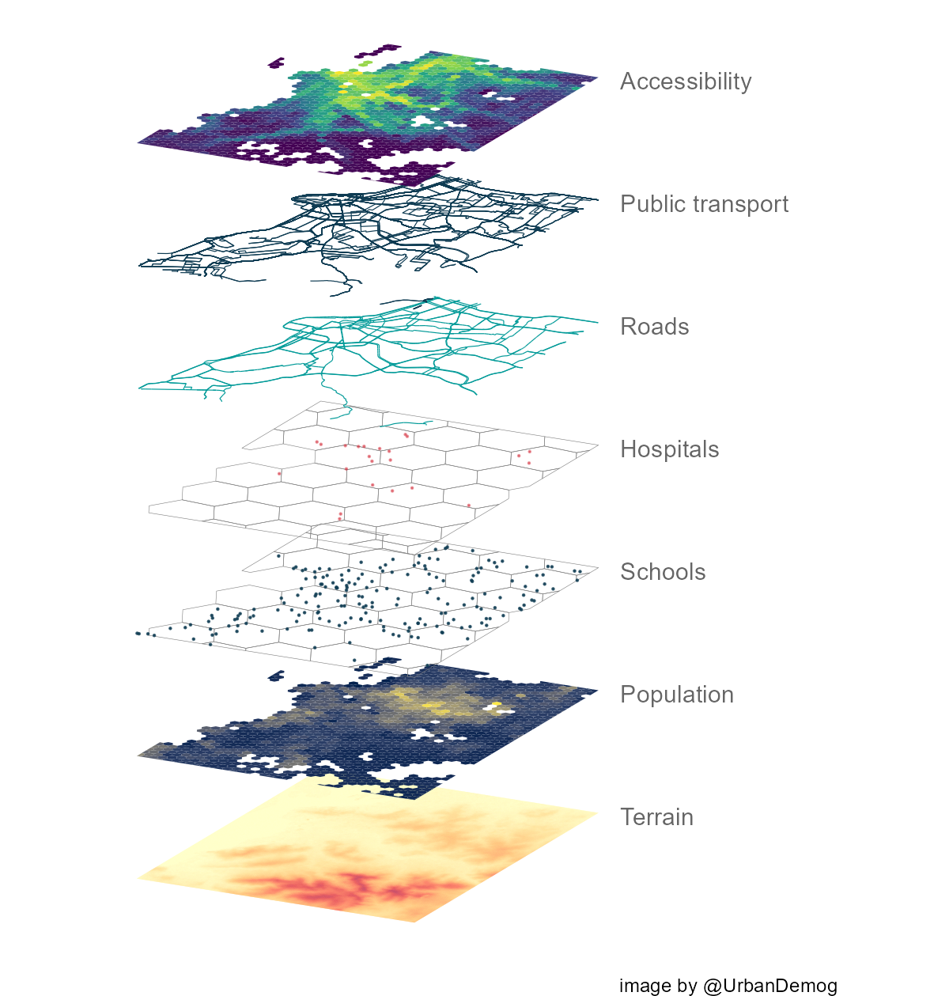
EXAMPLE 5: Raster and Vector Analytics
COMPUTE
BANDWIDTH
STORAGE

Slide 14
EXAMPLE 6: Machine Learning Models
COMPUTE
BANDWIDTH
STORAGE

Slide 15
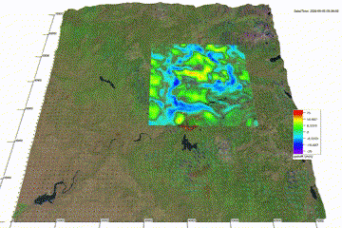
EXAMPLE 7: High Compute Analytics
COMPUTE
BANDWIDTH
STORAGE

Slide 16
OPTIONS
Compare and contrast the big three cloud providers and on-premises computing solutions.
11.04..22

Slide 17
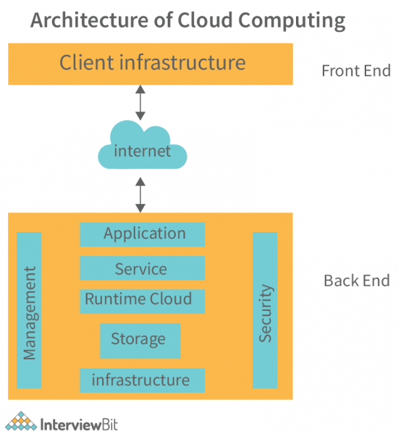
BASIC INFRASTRUCTURE
Cloud Delivery
The Software as a Service (SaaS)
The Platform as a Service (PaaS)
The Infrastructure as a Service (IaaS)
Notes:
Application: A substantial part of the application architecture is a user interface used by clients. It offers backend services to be able to access the data of clients. This layer deals with their requirements and requests.
Service: Cloud computing at the backend is a magical area of development that adds utility to every cloud hosting system. Service allows for every task running on the cloud to be executed. Some popular services are such as administration and application programming, storage, and web services, which each allow for various tasks to run quickly and efficiently on a cloud runtime environment.
Cloud Runtime: The term ‘Cloud Runtime’ is a buzzword that refers to the concept where services are readily accessible. This is just like a cloud operating system that makes use of technology such as virtualization and allows people to access countless networked servers at any given time. These servers act as individual storage drives, so while they are being supported by virtualization infrastructure, they act independently from each other and form the main server known as Hypervisors. A few examples of leading hypervisors are VMWare Fusion, Oracle VM for x86, Oracle Virtual Box, and many more.
Storage: Cloud storage is where the data resides within a cloud application. A dedicated portion of the cloud is commonly used for this purpose. Examples include solid-state drives (SSDs), hard disk drives (HDDs), Intel Optane DC Persistent Memory, and more! HDDs in server bays form most of the storage in the system, with solid-state storage or flash devices making up a small piece. In a cloud computing system, partitioning software divides the capacity from these two resources into sections that are suitable to run multiple services using an operating system (OS).
Infrastructure and Architecture: The engine that steers all cloud software services is known as infrastructure. It’s a broad term and covers various technologies, such as CPU, Motherboard, Graphics Processing Unit (GPU), network cards, accelerator cards, etc. An infrastructure model depends on the workload of your customers.
Management: The management software is the ‘middleware’ for a cloud computing system. It makes sure that if there are tasks related to different fronts in your business, then this kind of software allocates different resources to every task and makes sure that every task gets its share of attention.
Security: Security is integral and critical. Security structure in the architecture is created by keeping one thing in mind – you need to keep track of debugging processes. Bugs are dealt with daily, even hourly. Regular system backups are a must because what’s the use of anything if things can’t be retrieved when necessary? The cloud is not immune from virtual threats either, so firewall software comes into play in order for security infrastructure as a whole to work.

Slide 18
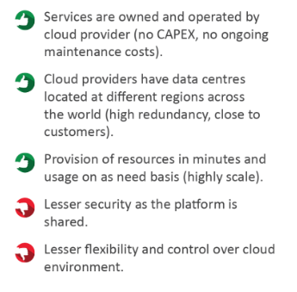
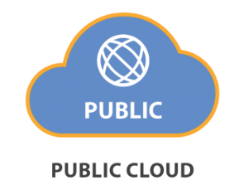
Cloud Computing
Where a third-party service provider makes computing resources available for consumption on an as-needed basis.

Slide 19
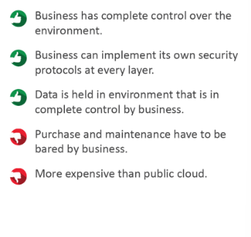
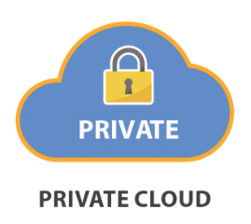
On-Premises
"On-prem" refers to software that runs on hardware that’s physically located on the premises or in a data center.

Slide 20
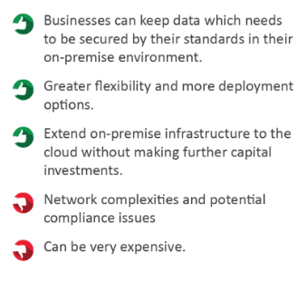
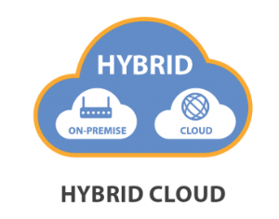
Hybrid Cloud
A combination of at least 2 computing environments that share information with one another and run a uniform series of applications.

Slide 21
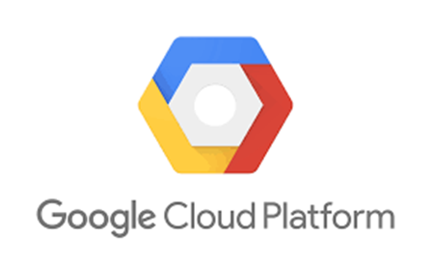
Top Three Cloud Providers

Slide 22
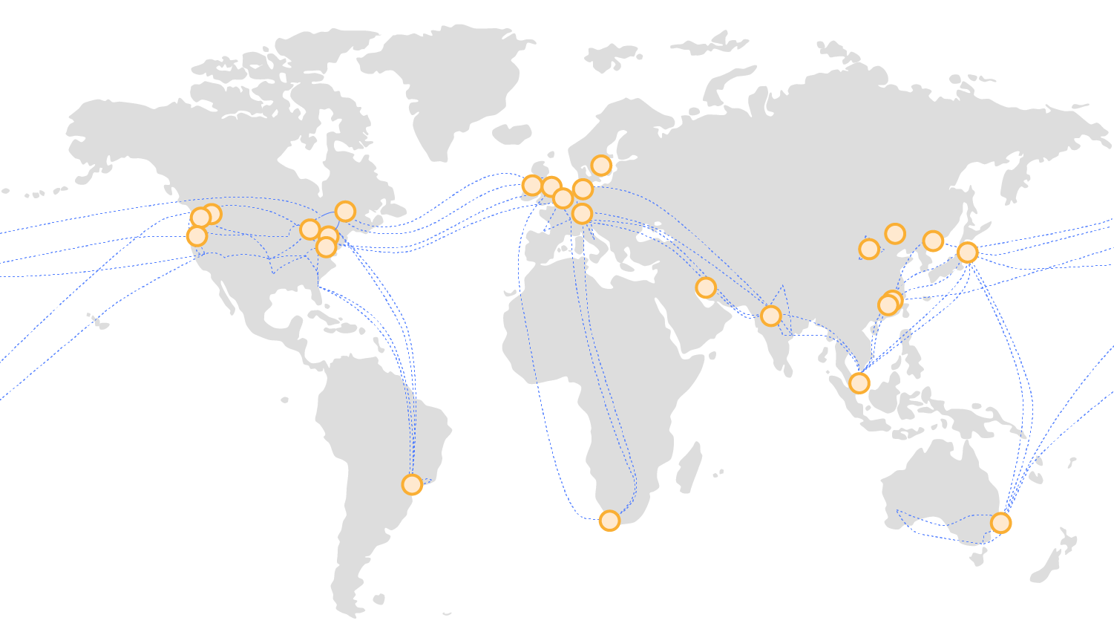
Notes:
https://aws.amazon.com/about-aws/global-infrastructure/global_network/

Slide 23
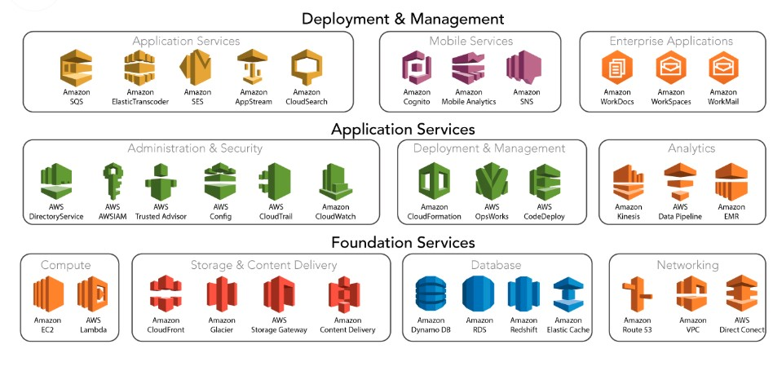
Notes:
SERVICES: 200+
Available since the early 2000s
The platform is developed with a combination of infrastructure as a service (IaaS), platform as a service (PaaS), and packaged software as a service (SaaS) offering
Users include Netflix, BBC, Facebook, Spotify, and LinkedIn

Slide 25
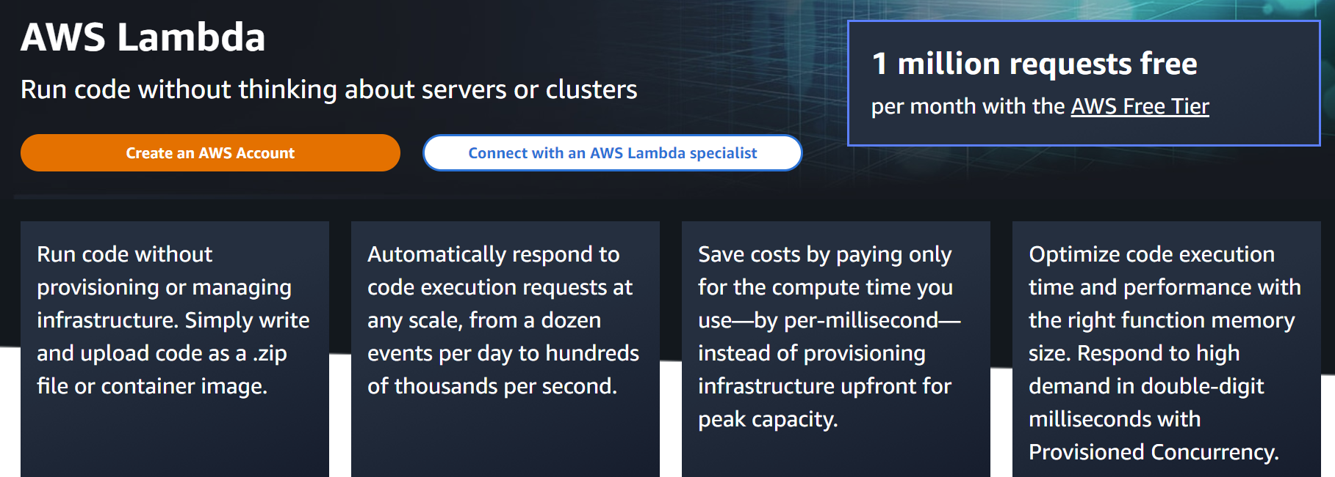

Slide 26
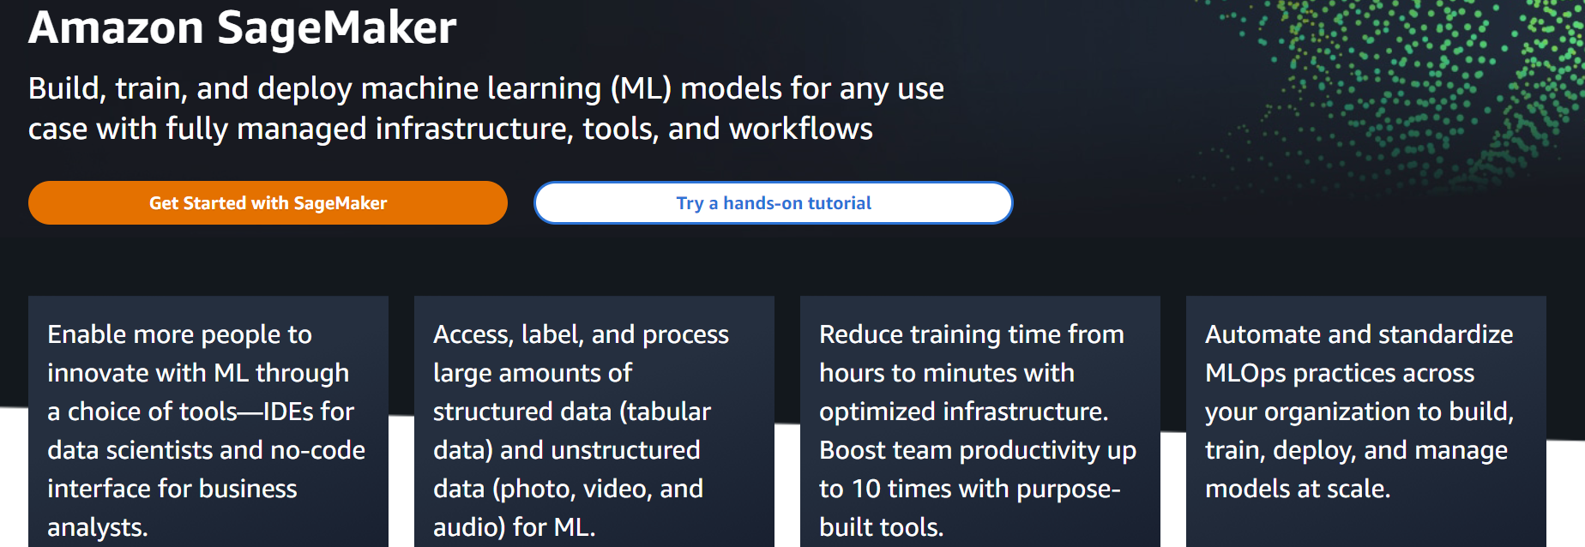
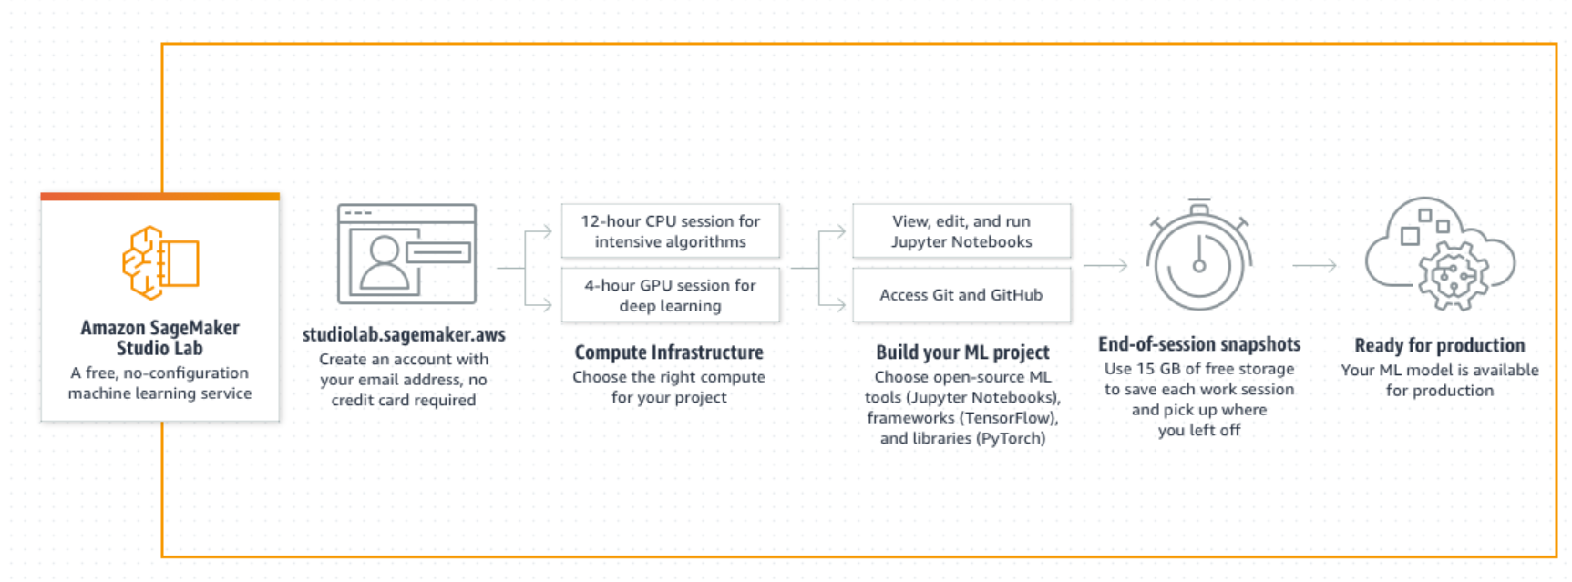

Slide 27
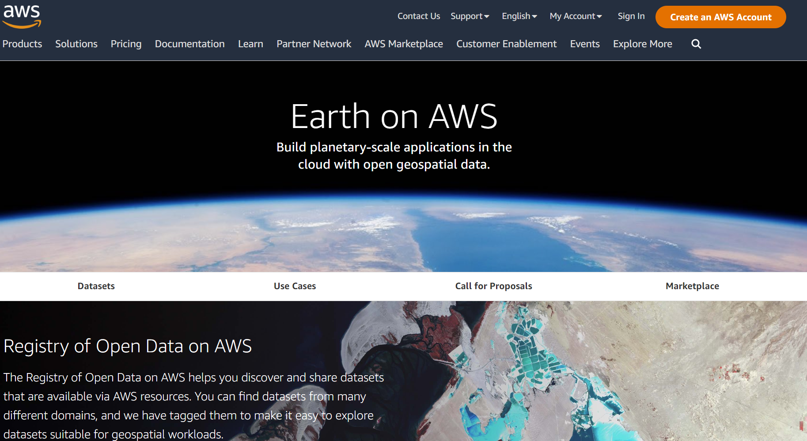

Slide 28
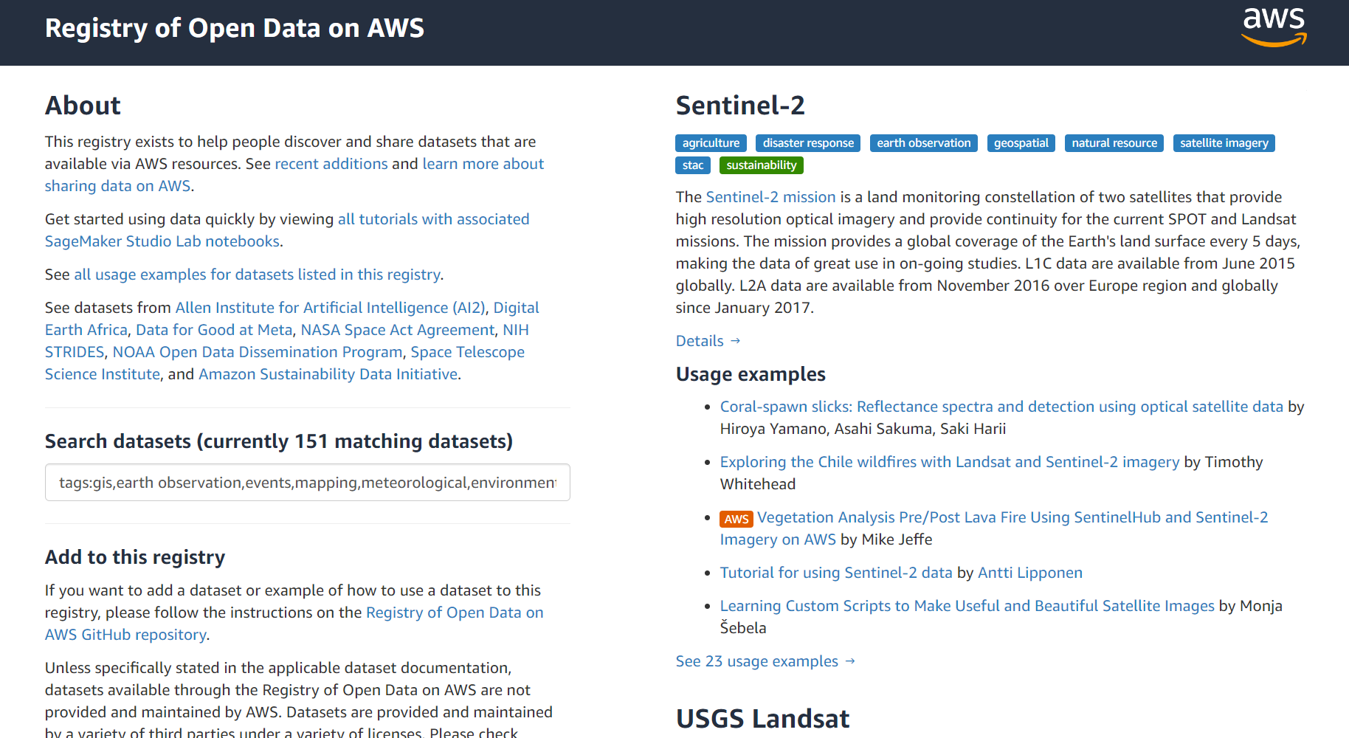

Slide 29
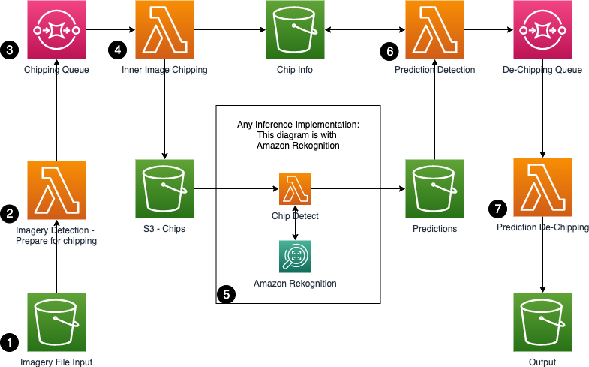
Processing satellite imagery with serverless architecture
https://aws.amazon.com/blogs/compute/processing-satellite-imagery-with-serverless-architecture/

Slide 30
Pros
Most services available, from networking to robotics
Most mature cloud service
Considered the gold standard in cloud reliability and security
More compute capacity vs Azure & GCP
All major software vendors make their programs available on AWS
Low Landsat Latency

Slide 31
Cons
Dev/Enterprise support must be purchased
Can overwhelm newcomers with the sheer number of services and options
Comparatively limited options for hybrid cloud
Limited spatial offerings
Limited data offerings

Slide 32
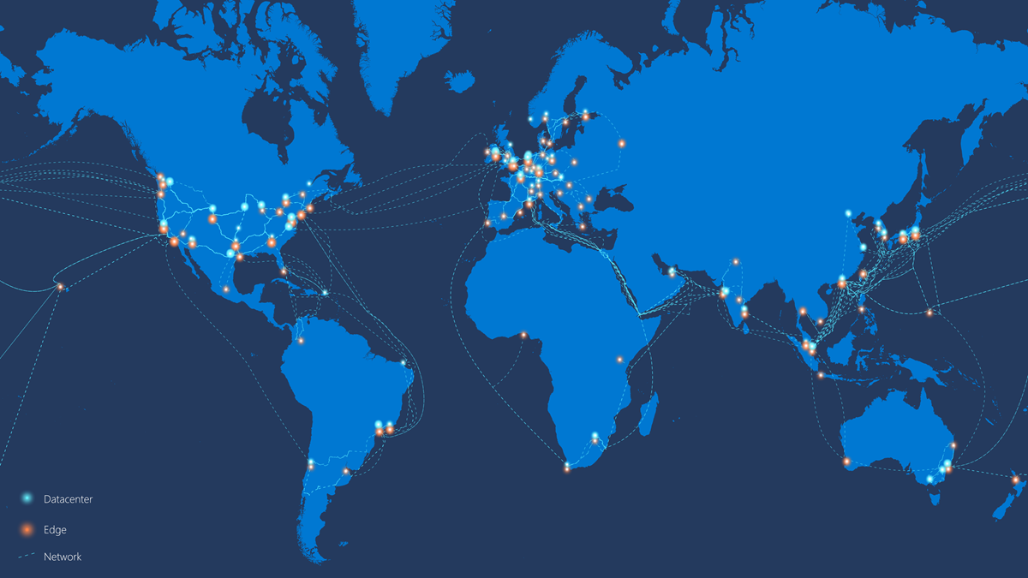
Notes:
https://learn.microsoft.com/en-us/azure/networking/microsoft-global-network
Available to the public since Q4 2008

Slide 33
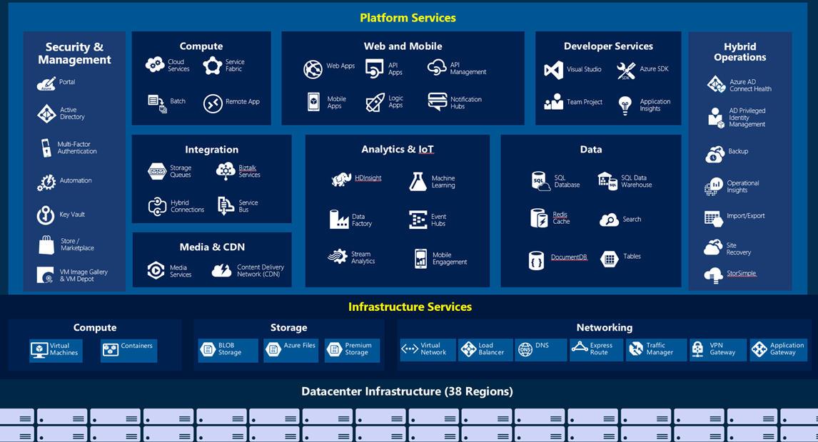
Notes:
200+ services

Slide 34
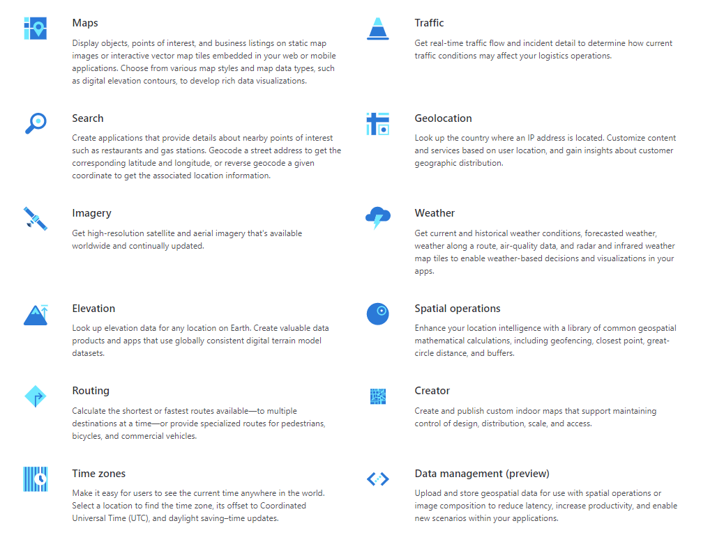

Slide 35
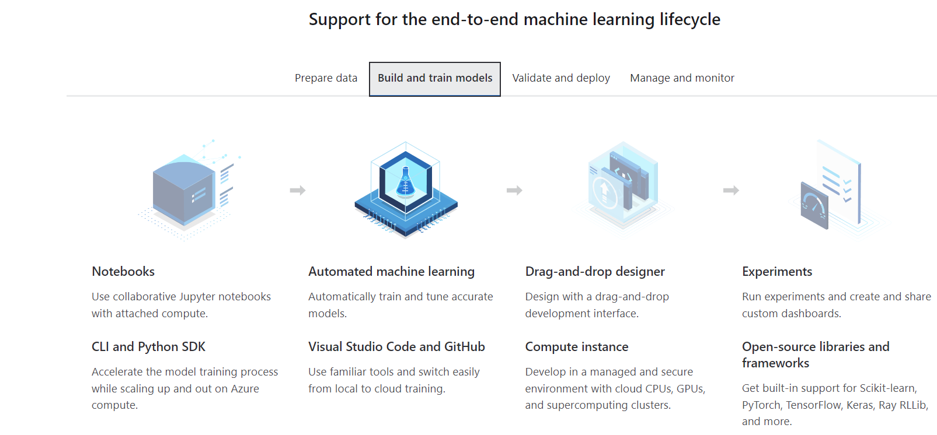

Slide 36
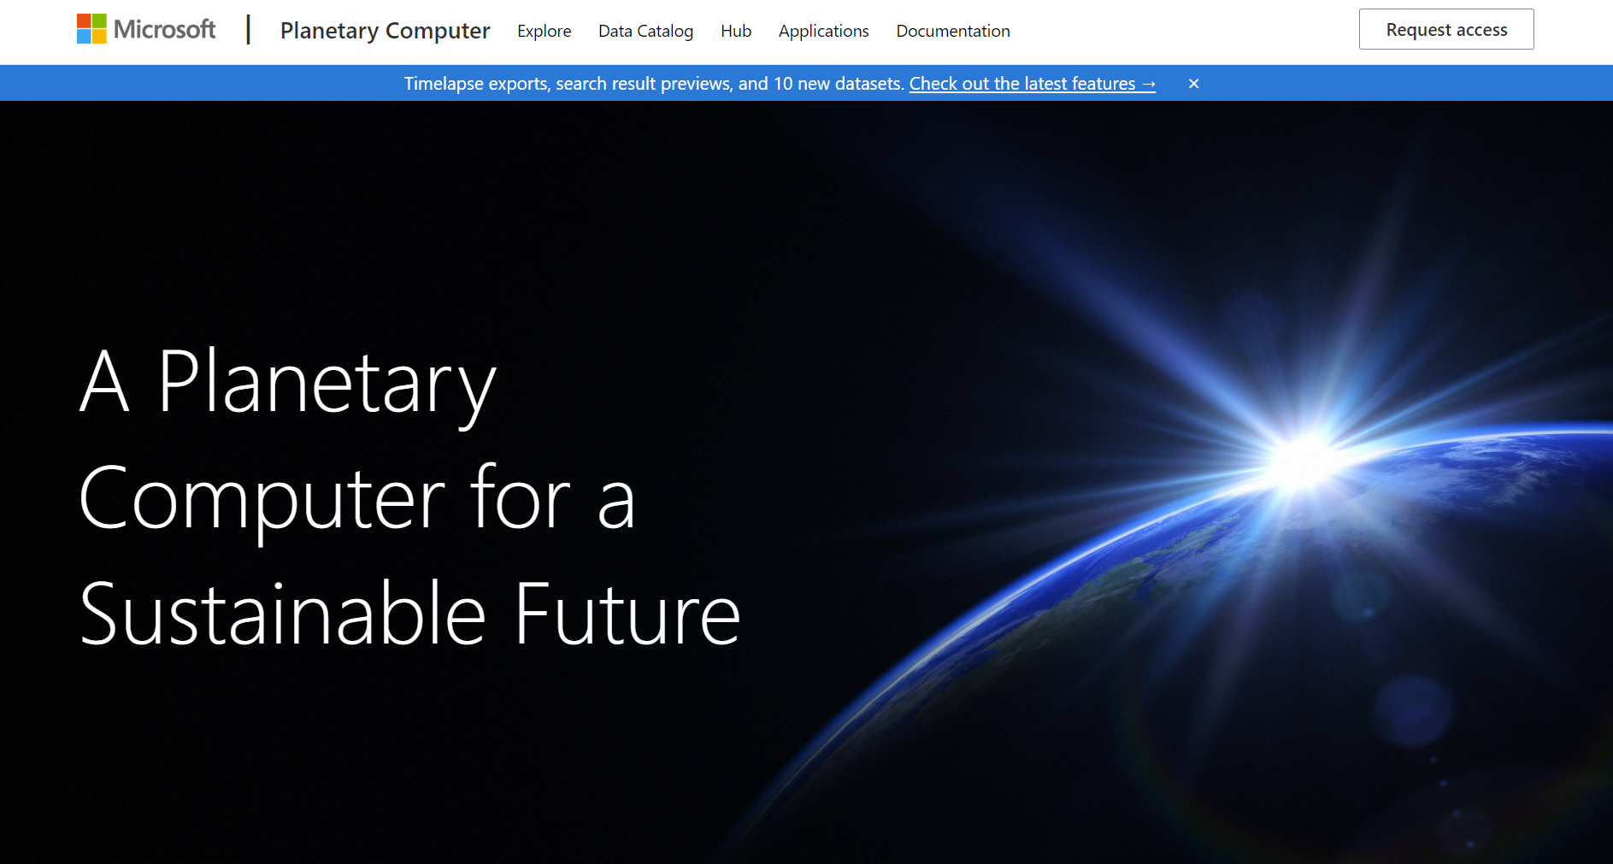

Slide 37
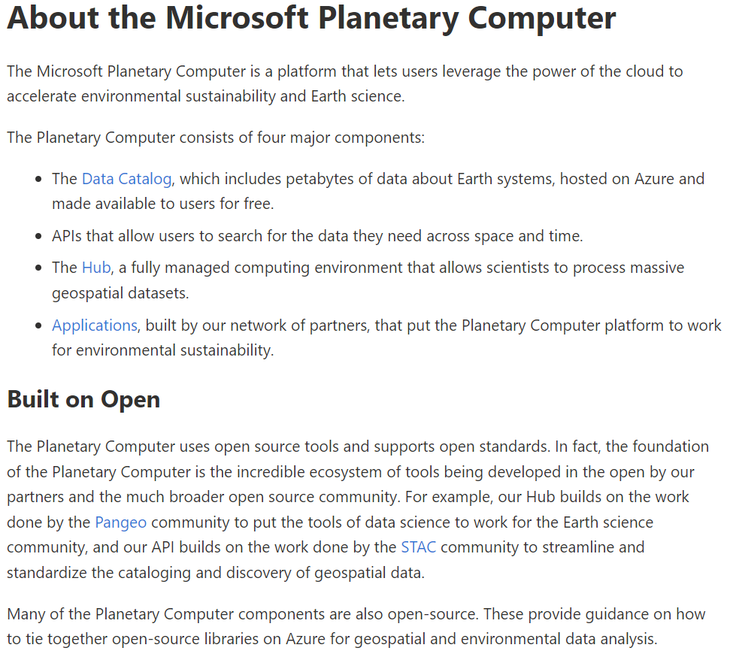
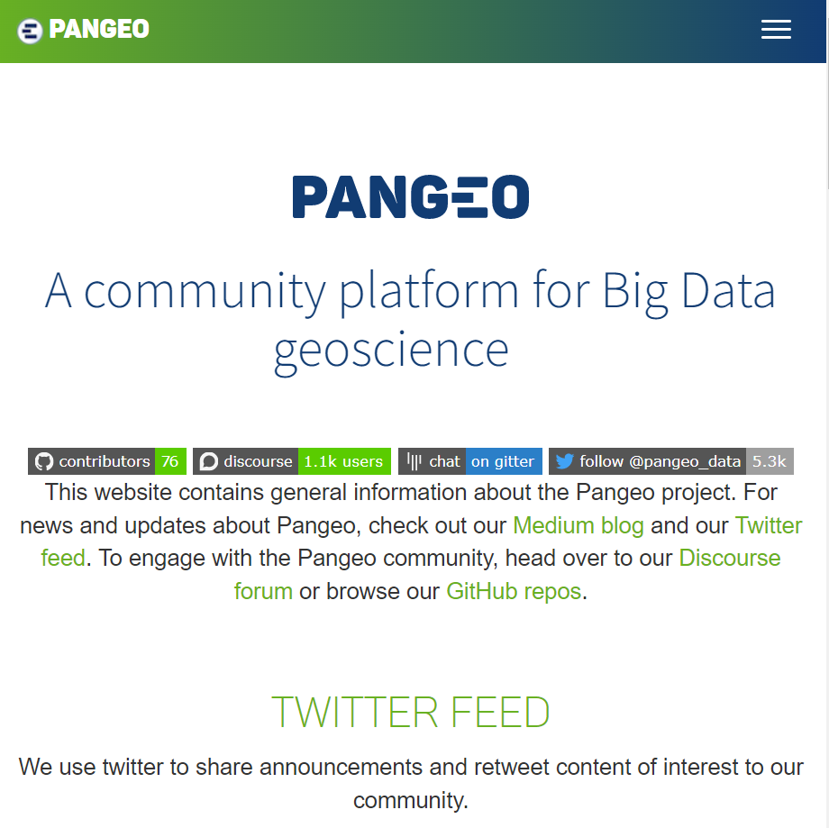

Slide 38
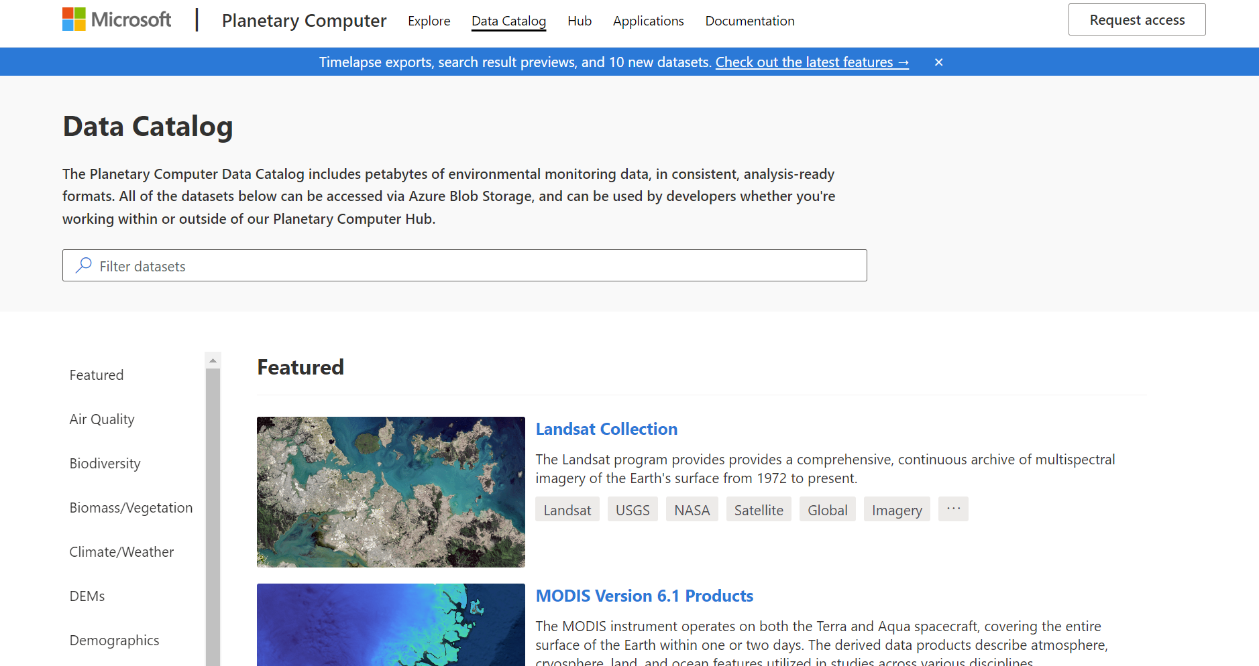

Slide 39
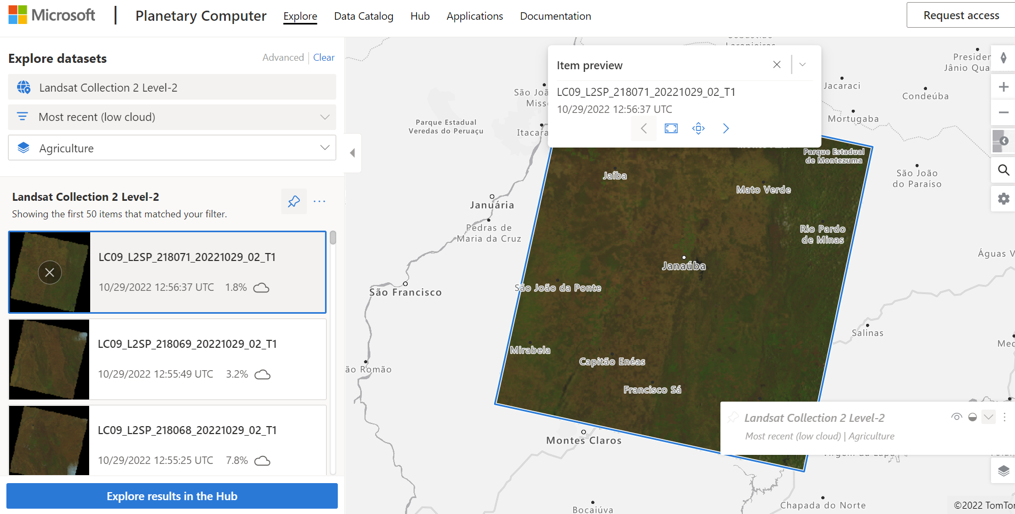

Slide 40
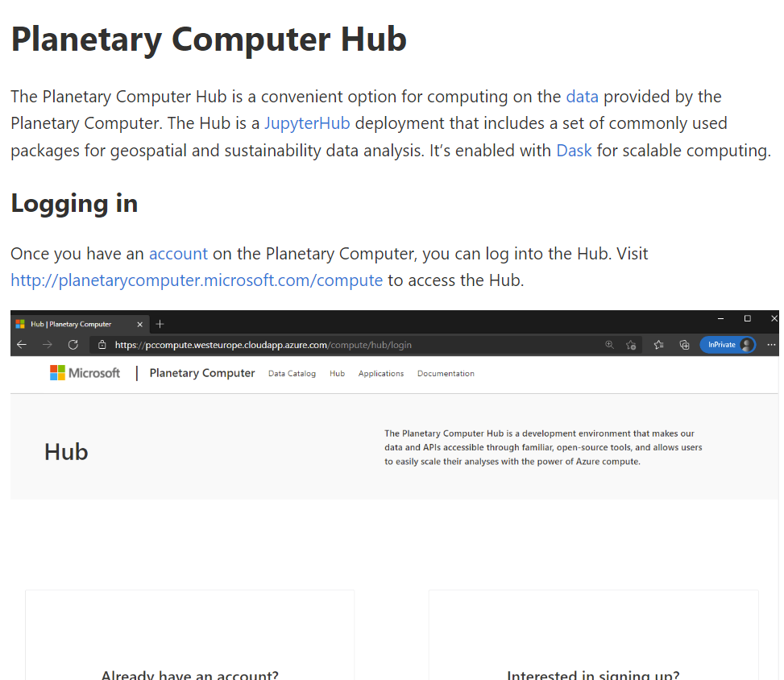
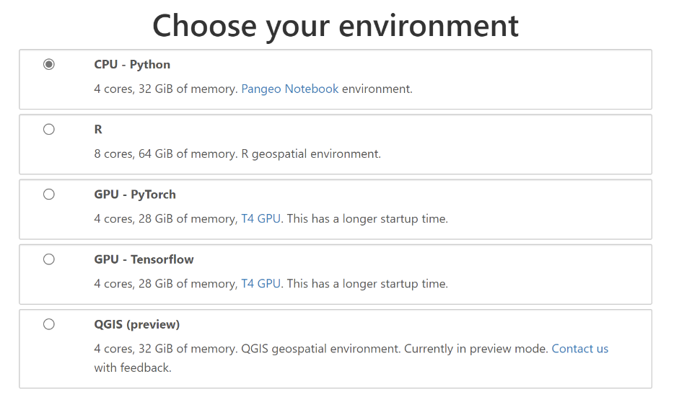
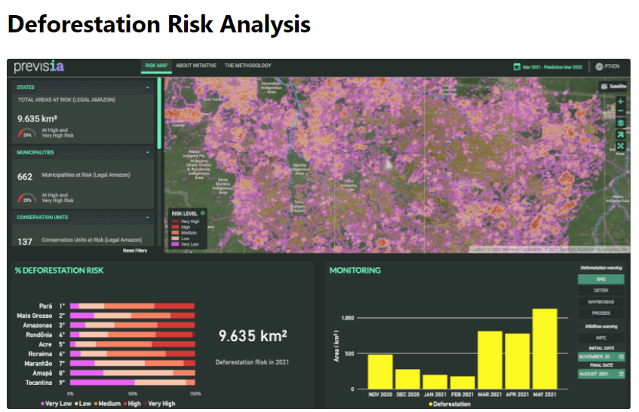

Slide 41
Pros
Easy integration and migrations for existing Microsoft services
Many services available, including best-in-class AI, ML, and analytics services
High availability and scalability
Great support for hybrid cloud strategies
Most powerful compute virtual machines (2021)
Open Spatial approach

Slide 42
Cons
Fewer service offerings vs AWS
Particularly geared towards enterprise customers
Comparatively more costly than other leading vendors
Additional charge for pay-as-you-go option
Customer service
Limited Data

Slide 43
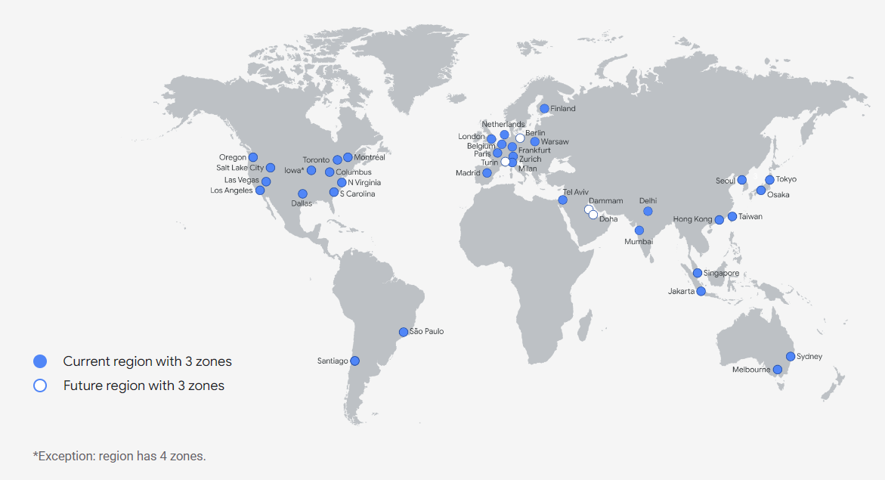

Slide 44
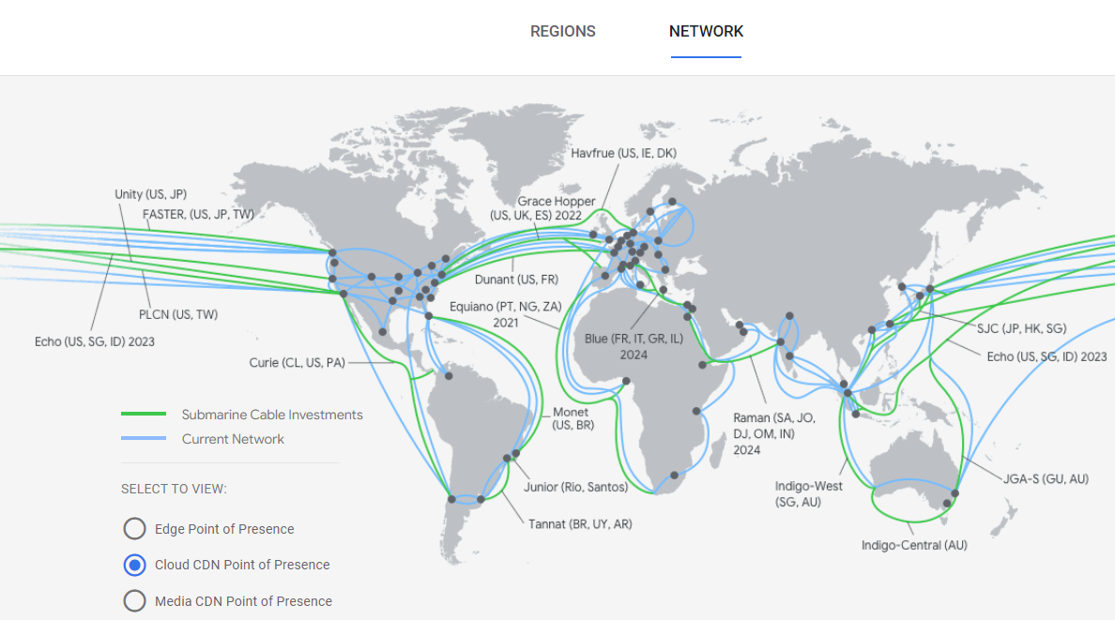

Slide 45
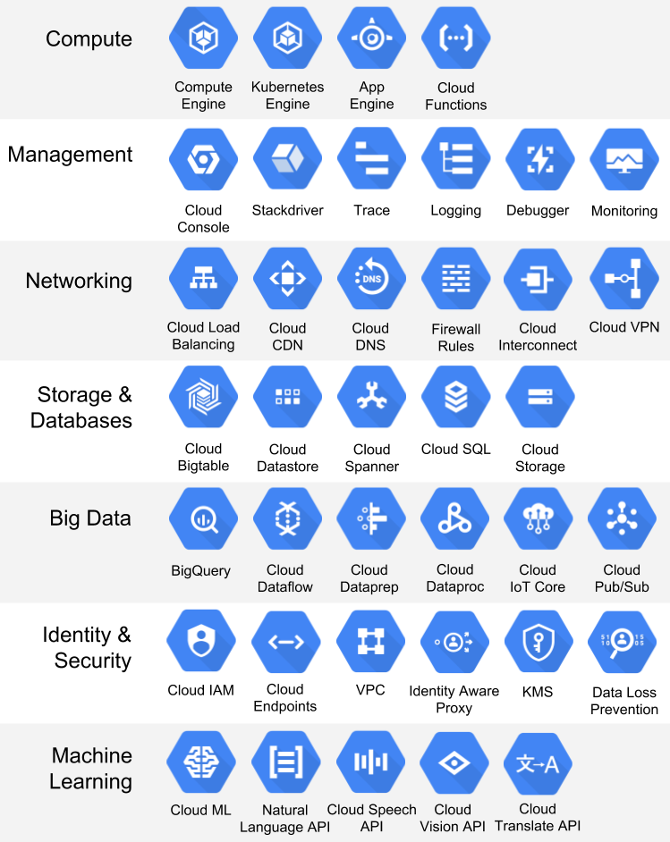

Slide 46
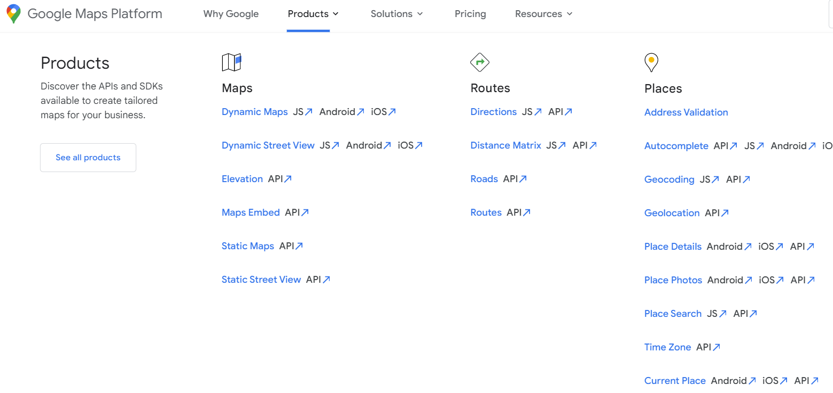

Slide 47
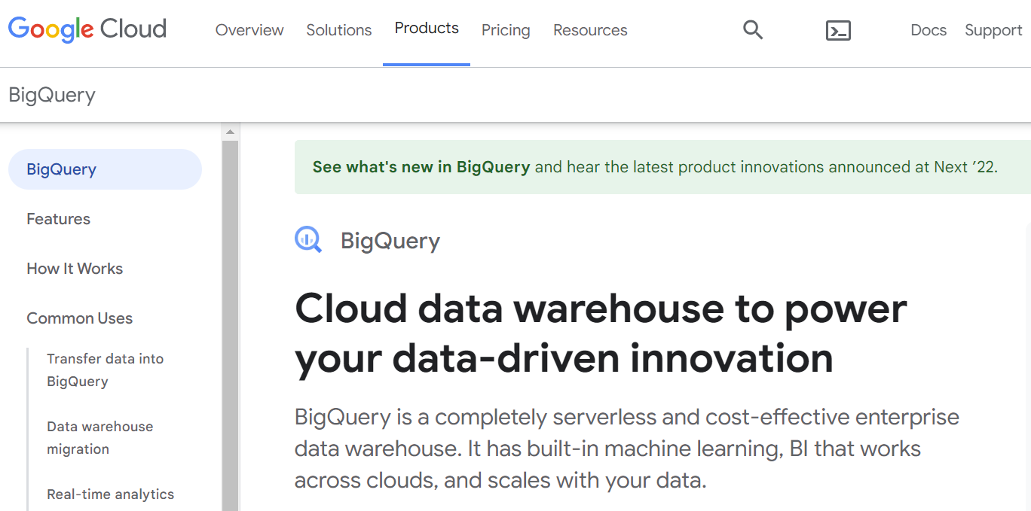

Slide 48
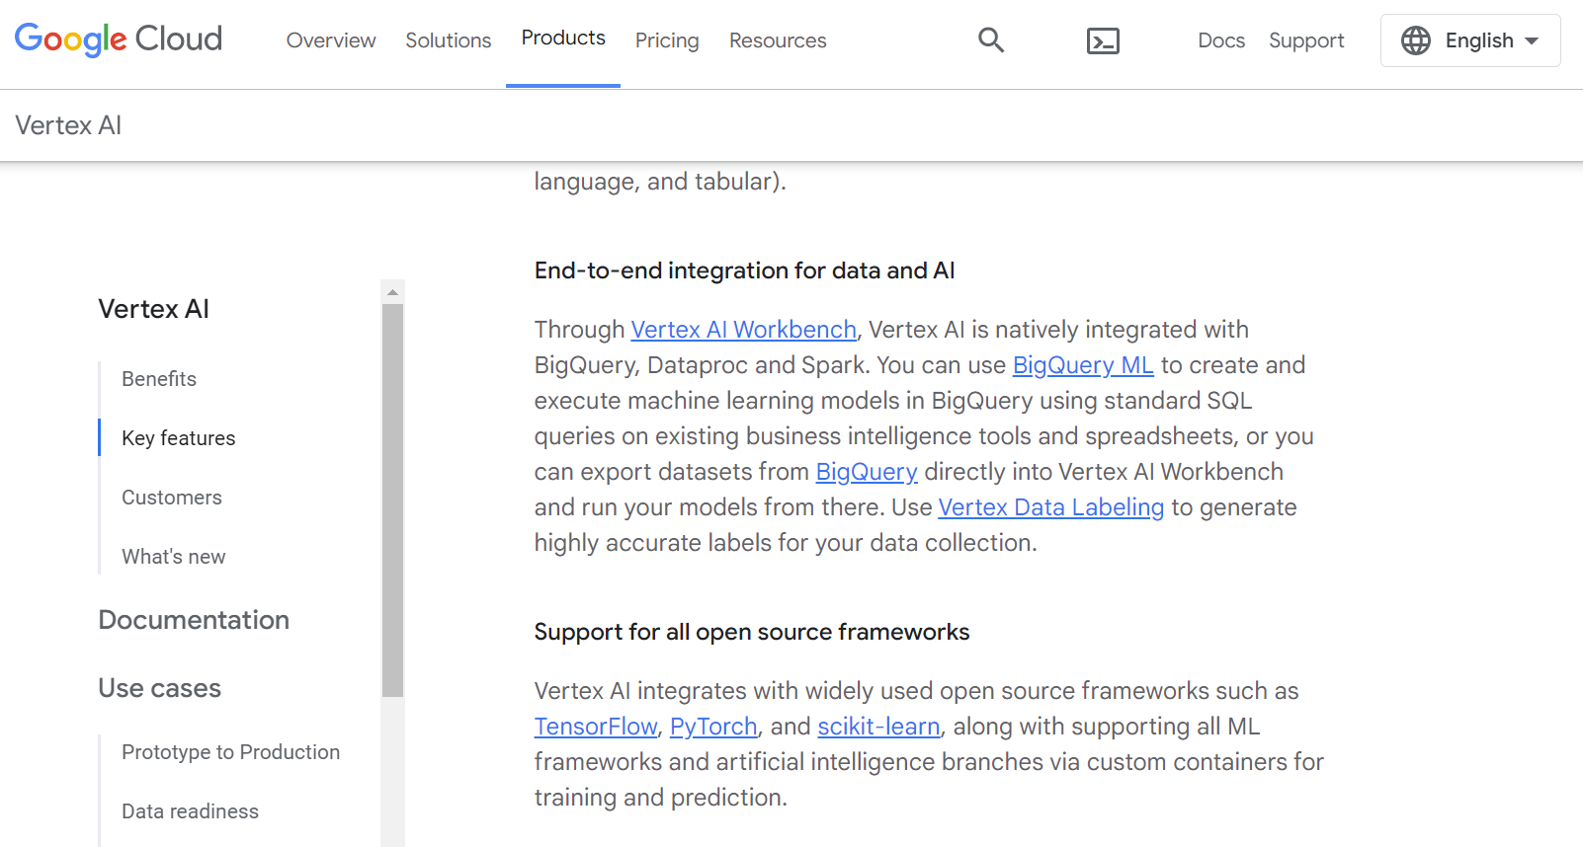

Slide 49
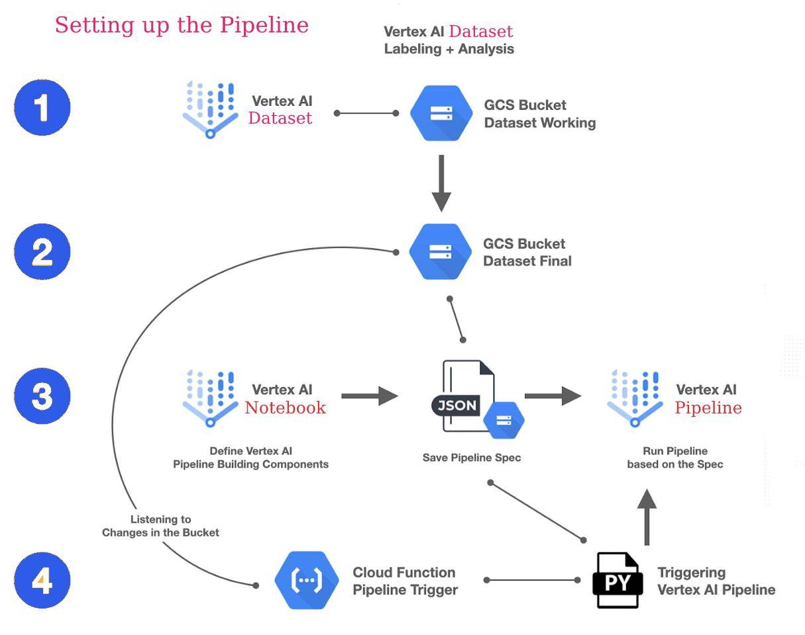

Slide 50
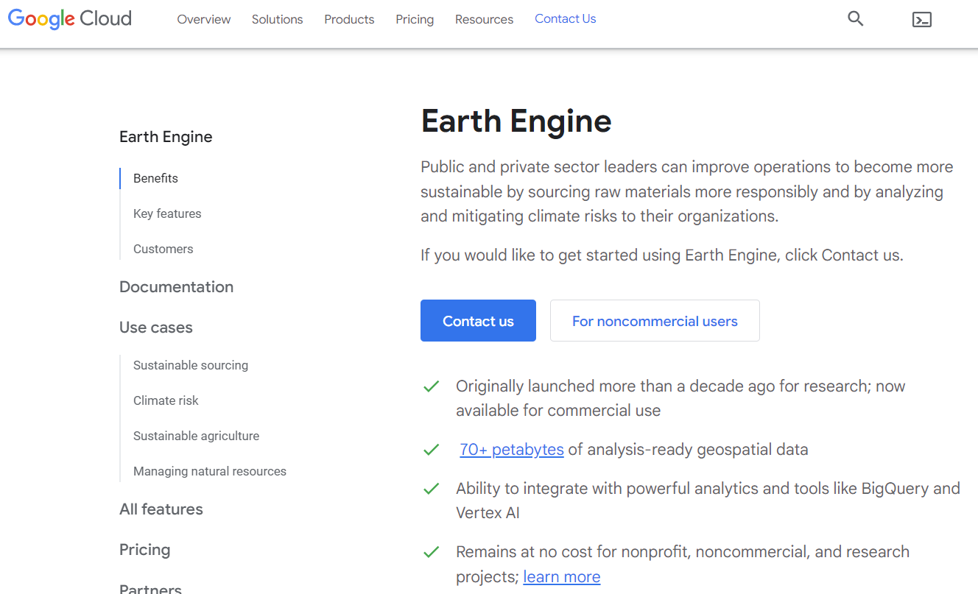

Slide 51
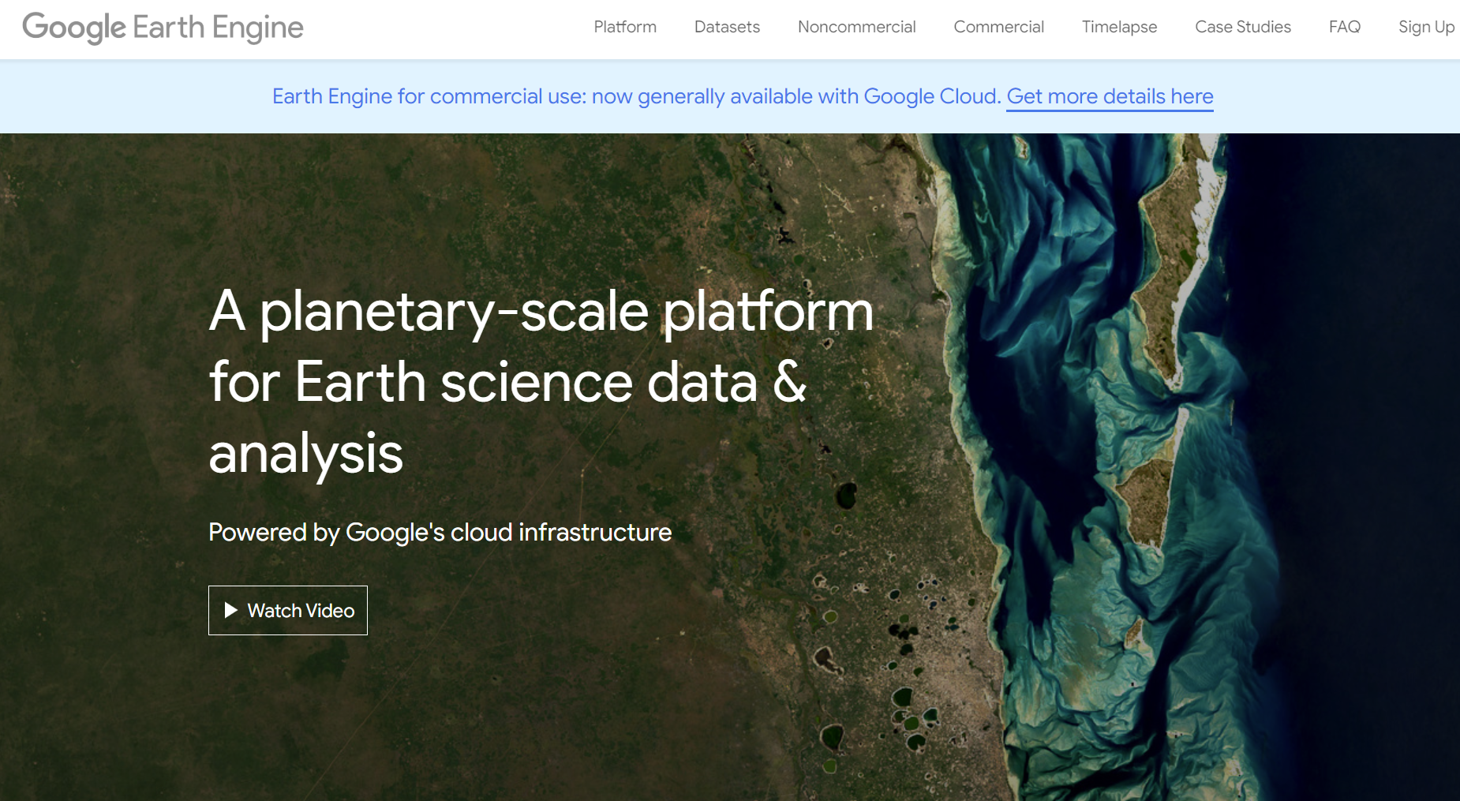

Slide 52
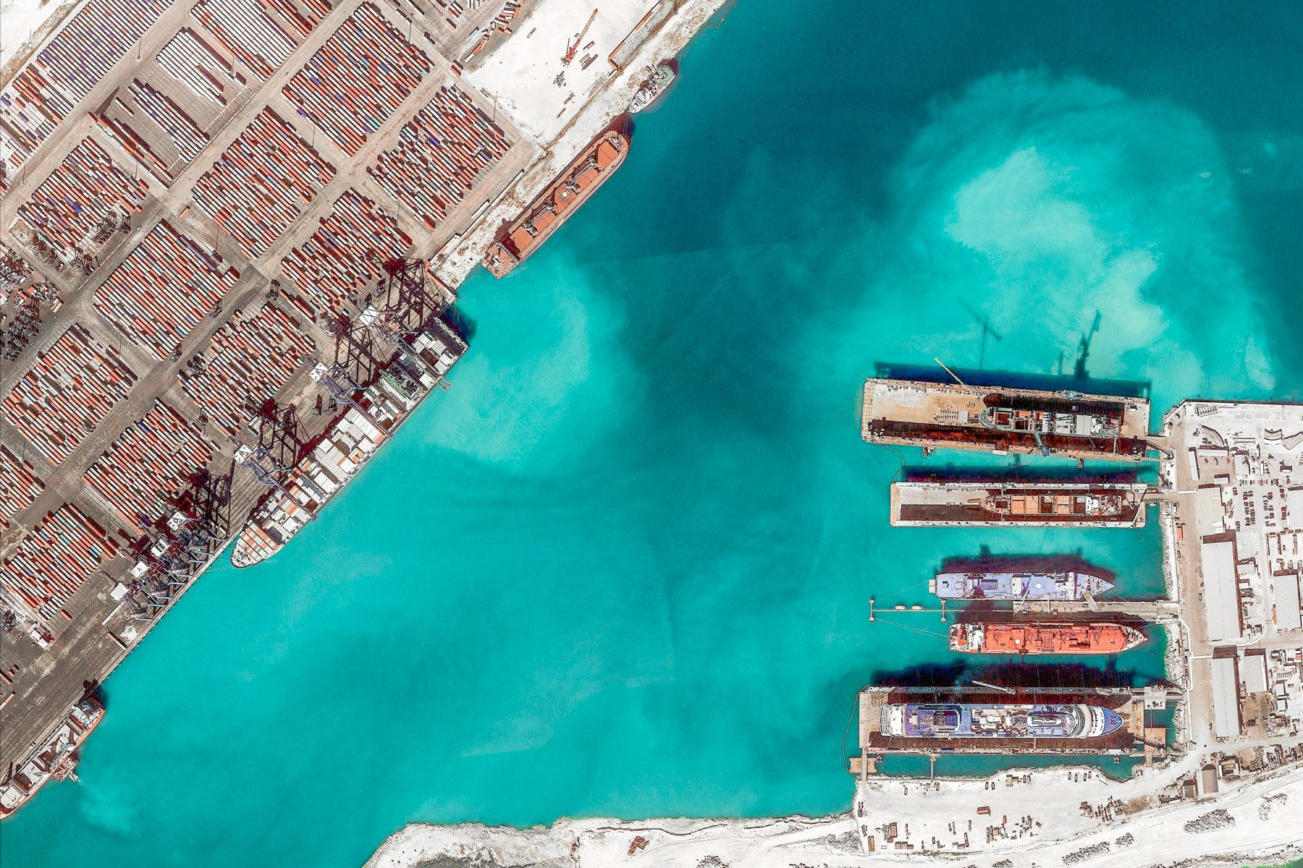
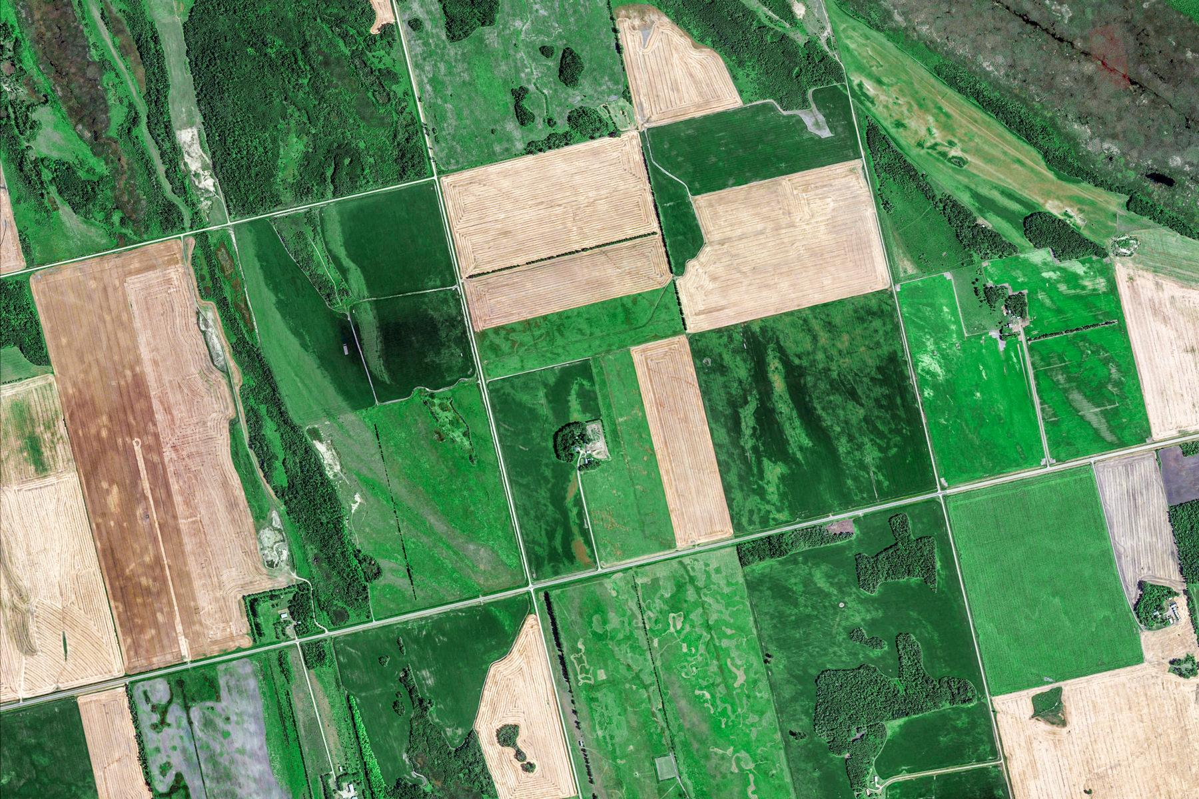
Growth and Impact
Resource Growth
Data Catalog: 70+PB, 900 datasets
Compute hours: 500M CPU hr/year
New User Growth
50K+ monthly active users
Scientific Paper Growth
Nearly 20K papers now reference Earth Engine

Slide 53
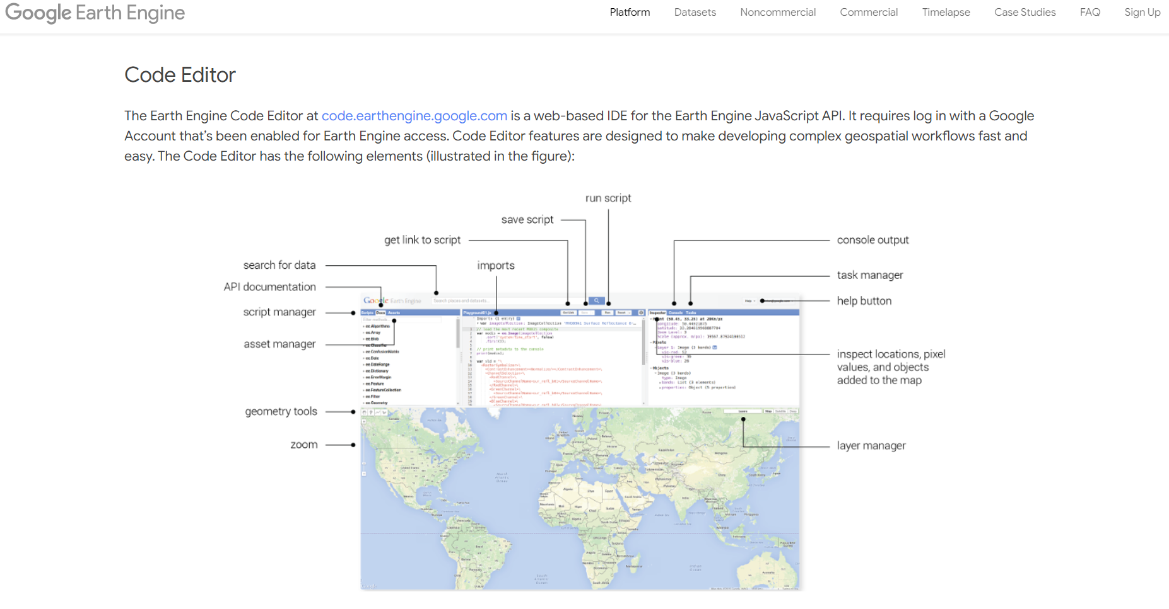

Slide 54
Community highlights
Cloud-Based Remote Sensing with Google Earth Engine
Fundamentals and Applications
Editors:
Jeffrey A. Cardille - McGill University
Nick Clinton - Google
Morgan A. Crowley - McGill University
David Saah - University of San Francisco
eefabook.org

Slide 55
Pros
Plays nicely with other Google service and products
Excellent support for containerized workloads
APIs for natural language, translation, speech, and more
Fast I/O
Global fiber network
Earth Engine Integration (this is huge)

Slide 56
Cons
Limited services vs AWS & Azure
Limited support for enterprise use cases
Majority of components based on Google proprietary tech
No real control over Virtual Machines
Fewer global data centers

Slide 57
Tools and Services
Overlay

Slide 58
Cloud Costs to Consider
Public IP address are charged for monthly
SSD or high IOps storage is available for a premium fee
Ingress is free, but egress can add significant costs
Spot or preemptible instances can be beneficial
Storage is charged for monthly even if it isn’t utilized
Powered down instances don’t cost money

Slide 59
On-Premises
"On-prem" refers to software that runs on hardware that’s physically located on the premises or in a data center.

Slide 60
On-Prem: Infrastructure Expenditure
Necessary Hardware
Firewalls
Fast enough to match purchased bandwidth
Licensed services (IPS, anti-virus, anti-malware, etc.)
Switches
10Gbps or more for server interconnectivity
1Gbps for OOB management
Custom Servers and Storage
Software (VMware, Linux, Microsoft, etc.)

Slide 61
On-Prem: Choosing a Data Center
Things to look for
Location
How easily can someone from your hub get to the physical location?
How prone the area is to natural disasters?
Are there plenty of power available and lots of fiber paths going to and from the building?
Reliability
A reliable provider should have a 99.999% uptime?
Do they offer a 100% uptime SLA?
What kind of backup systems (generators, batteries, etc.) are located onsite?
Deployment Efficiency
How fast do you need your infrastructure up and running?
How quickly do you think you'll need a new cross connect or additional rack space in the future?

Slide 62
On-Prem: Choosing a Data Center
Things to look for
Network Ecosystem
Is the facility carrier-neutral?
How many Internet Exchange Points are they hosting?
Do they have a large ecosystem of customers already interconnecting?
Lemming Effect
How many other providers are in the area?
If many providers have built facilities in the same area, odds are good that it is geographically hospitable, has good network connectivity, and reliable utility services to provide power and water.
Financial Stability
Take the financial stability of the provider into account.
Ideally, your data center should be able to support you for at least five years, if not longer.

Slide 63
On-Premises, But Physically Onsite?
Pros
Give you physical control over infrastructure
Keep sensitive and critical data onsite
Remove access from third parties to sensitive information
Access data with no internet connection
Cost effective for experimentation and huge computational requerments

Slide 64
On-Premises, But Physically Onsite?
Cons
It requires monetary investment in infrastructure and hardware
It requires space, as well as a dedicated team (more money)
It may be more susceptible to data loss during disasters
It takes longer to implement and install applications and software
You must update systems yourself
Technical skills are required/fully trained IT and technical department
It’s only manageable on-site
It has limited scalability due to infrastructure
You can experience unpredictable downtime

Slide 65
Which cloud provider is right for me?
Big Decision
A 2022 report† has in fact shown that 89% of organizations reported having a multi-cloud strategy; 80% opted for a hybrid solution (combining public and private clouds).
When looking for the right cloud vendor for your hub, be sure to consider your particular requirements and workload
The answer could be a combination of two or three cloud providers plus on-premises.
† Flexera 2022 State of the Cloud Report

Slide 66
What Does SIG Choose?
Everything!
By selectively choosing available services offered by the big three cloud providers and utilizing on-premises solutions, SIG can maximize it’s investments and opportunities.

Slide 67
Services
Route 53 – Highly available and scalable Domain Name System (DNS) web service
EC2 – Inexpensive small instances for development or testing
S3 – Storage that is compatible with many existing software packages and services
Glacier – Long term, inexpensive cold storage for rarely used datasets

Slide 68
Features
Virtual Machines – HBv2-series contain custom AMD EPYC CPUs made specifically for Microsoft with SME disabled. These nodes offer 120 real (not virtual) cores, 456GB of RAM, and local storage with very high IOps.
Premium SSD Managed Disks – High IOps storage to support heavy compute instances
General Block Blob – Inexpensive storage for temporary data

Slide 69
Features
Compute Engine – Configurable virtual machines running in Google's data centers with access to GEE
VPC Network – A global resource that consists of a list of regional virtual subnets in data centers, all connected by a global wide area network
Google Workspace Business Standard – Secure collaboration and productivity apps, includes Gmail, Drive, Meet and more
Google Earth Engine – Geospatial processing at scale

Slide 70
SIG On-Premises Data Center
Hurricane Fremont 2 Colocation Facility
3000 Cabinets
3 Internet Exchange Points (SFMIX, AMS-IX Bay, and FCIX)
150 Internet Networks
7 Carriers with Diverse Fiber
200,000 square feet
24 x 7 x 365 Onsite Staff, Remote Hands, and Access
UPS and Generator backup power
Individually locked cabinets
Custom designed video surveillance of every cabinet
Card keyed doors and other onsite security measures
Diverse A & B Power Available (fully separate PDUs, Panels, Transformers, Generators)

Slide 71
SIG On-Premises Hardware
Hardware
Firewalls –Licensed Gen7 SonicWall NSa 2700 Network Security Appliances
Capture Advanced Threat Protection
Gateway Intrusion Prevention, Anti-Virus, Anti-Spyware
Application Firewall Service
Content Filtering Services
Comprehensive Anti-Spam
IPSEC and SSL VPN
24x7 Support with firmware
Networking – 10Gbps Cisco or FS switches and 56Gbps Infiniband
Data center features to build a lossless and low-latency network
Support Multi-Chassis Link Aggregation for uninterrupted services
Redundant hot-swappable power supplies and smart fans
OOB Network – 1Gbps Cisco switches

Slide 72
SIG On-Premises Hardware
Hardware
Custom Supermicro Servers for Compute
3,328 CPU cores with 24.5TB of RAM
80TB of NVMe local storage
Custom Supermicro Servers for Storage
76 CPU cores with 2.4TB of RAM
2.62PB of raw HDD storage
Custom Supermicro Servers for Vmware
756 CPU cores with 6TB of RAM
78TB of mixed SSD and NVMe local storage
Custom Supermicro Servers for Web Services
256 CPU Cores with 1.2TB of RAM
68TB of mixed SSD and HDD local storage

Slide 73
EXAMPLES
Show an examples of different configuration
11.04..22

Slide 74
EXAMPLE 1: Hydrafloods
COMPUTE
BANDWIDTH
STORAGE

Slide 75
EXAMPLE 2: FireFactor
COMPUTE
BANDWIDTH
STORAGE

Slide 76
EXAMPLE 3: DE Africa
COMPUTE
BANDWIDTH
STORAGE

Slide 77
EXAMPLE 4: ESRI DE Africa
COMPUTE
BANDWIDTH
STORAGE

Slide 78
DISCUSSION
Because pure presentations are boring
David Saah, PhD
dssaah@usfca.edu or dsaah@sig-gis.com
11.04..22

